Slide 1
Asymmetric Encryption and Digital Signatures
Unit 5.2
Cybersecurity Boot Camp |

Slide 2
Warm-Up Activity: Cryptography Refresher (7 min)
In this activity, you’ll answer questions to review the topics covered in Day 1
Instructions:
Complete the activity using the instructions in the file provided to you

Slide 3
Cryptography Refresher
Instructor Review

Slide 4
Today’s Goals
By the end of class, you will be able to:
Compare and contrast block and stream ciphers
Describe how public key cryptography uses a keypair for encryption and decryption
Use a command line program, GPG, to encrypt and sign documents with public/private keys
Describe how digital signatures use private and public keys to generate and verify signatures
Describe and explain how digital certificates verify digital entities
Notes:
Review goals; address any questions.

Slide 5
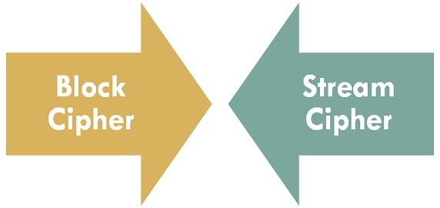
Block vs Stream Ciphers

Slide 6
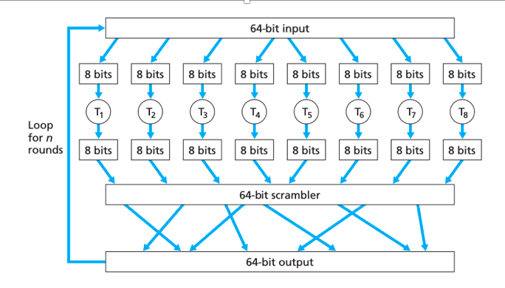
Block Cipher

Slide 7
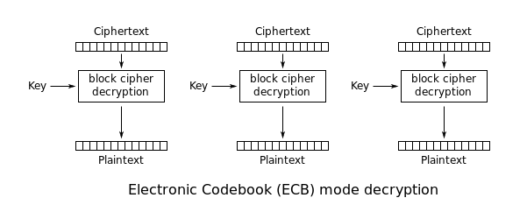
Block Cipher in Stream Mode

Slide 8
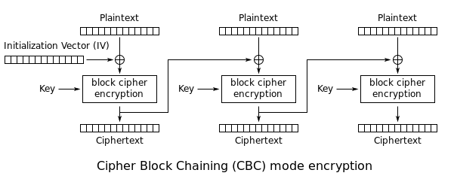
Block Cipher in Stream Mode

Slide 9
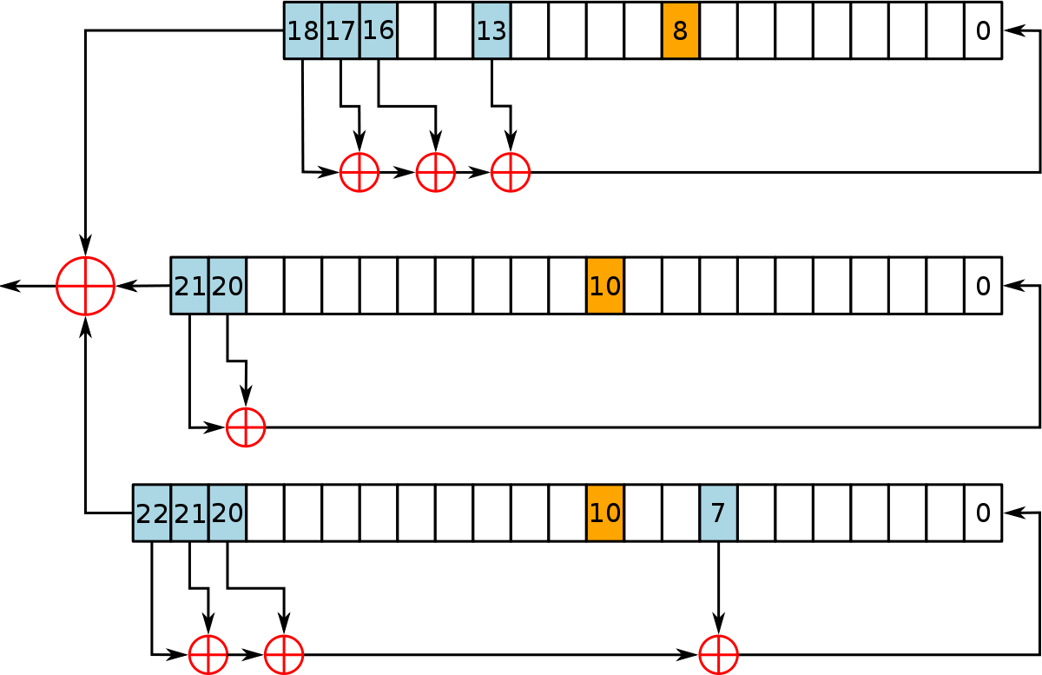
Stream Cipher

Slide 10
Today’s Goals
By the end of class, you will be able to:
Compare and contrast block and stream ciphers
Describe how public key cryptography uses a keypair for encryption and decryption
Use a command line program, GPG, to encrypt and sign documents with public/private keys
Describe how digital signatures use private and public keys to generate and verify signatures
Describe and explain how digital certificates verify digital entities
Notes:
Review goals; address any questions.

Slide 11
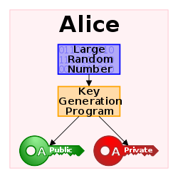
Public Key Cryptography

Slide 12
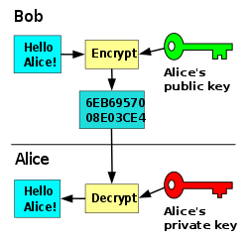
Public Key Cryptography

Slide 13
Activity: Public Key Cryptography (10 min)
In this activity, you will:
Investigate a specific scenario to review the structure of asymmetric algorithms.
Learn about the the SSL/TLS Handshake
Instructions:
Complete the activity using the instructions in the file provided to you

Slide 14
Today’s Goals
By the end of class, you will be able to:
Compare and contrast block and stream ciphers
Describe how public key cryptography uses a keypair for encryption and decryption
Use a command line program, GPG, to encrypt and sign documents with public/private keys
Describe how digital signatures use private and public keys to generate and verify signatures
Describe and explain how digital certificates verify digital entities
Notes:
Review goals; address any questions.

Slide 15

Public Key Encryption with GPG
1. Generate a public/private key
2. Export and share the key
3. Encrypt/Decrypt messages

Slide 16
Activity: Installing GPG (5 min)
In this activity you will ensure that you have GPG installed.
GPG comes pre-installed in GitBash
Mac users will need to do the following steps:
Go to https://brew.sh/
Copy and paste the command to install into Terminal
Once done, enter the command `brew update`
Then enter `brew install gpg`

Slide 17
Generating Keypairs and Encrypting/Decrypting with GPG
Instructor Demo

Slide 18
Activity: Encrypting with GPG (10 min)
In this activity you will use GNU Privacy Guard (GPG) to:
Generate a public/private keypair
Generate a revocation certificate
Encrypt and decrypt data
Instructions
Complete the activity using the instructions in the file provided to you

Slide 19
Encrypting with GPG
Instructor Review

Slide 20
Today’s Goals
By the end of class, you will be able to:
Compare and contrast block and stream ciphers
Describe how public key cryptography uses a keypair for encryption and decryption
Use a command line program, GPG, to encrypt and sign documents with public/private keys
Describe how digital signatures use private and public keys to generate and verify signatures
Describe and explain how digital certificates verify digital entities
Notes:
Review goals; address any questions.

Slide 21
BREAK

Slide 22
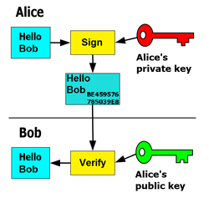
Digital Signatures

Slide 23
Signing with GPG
"All at once"
i.e., GPG generates an encrypted message with an appended signature
Clearsigned
i.e., GPG generates a signature, which it attaches to the unencrypted message
Detached Signatures
i.e., GPG generates an encrypted document, without an appended signature; and a separate file containing the signature

Slide 24
Activity: Signing Documents (13 min)
In this activity, you'll use GPG to
Sign documents
Verify signatures
Generate clearsigned documents and detached signatures
Instructions
Complete the activity using the instructions in the file provided to you
Answer the questions in the file as you complete the activity.
Note: You will need to figure out how to generate detached signatures and clearsigned documents

Slide 25
Signing Documents
Instructor Review

Slide 26
Today’s Goals
By the end of class, you will be able to:
Compare and contrast block and stream ciphers
Describe how public key cryptography uses a keypair for encryption and decryption
Use a command line program, GPG, to encrypt and sign documents with public/private keys
Describe how digital signatures use private and public keys to generate and verify signatures
Describe and explain how digital certificates verify digital entities
Notes:
Review goals; address any questions.

Slide 27

Digital Certificates

Slide 28
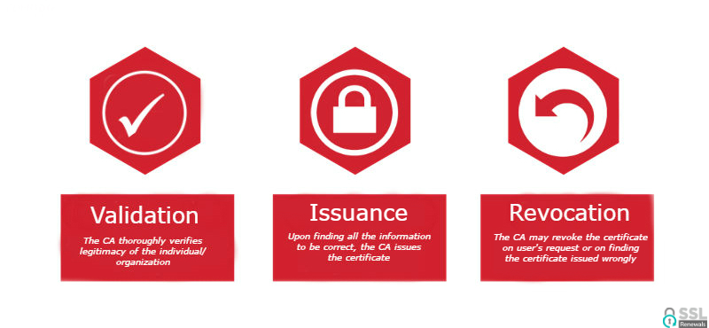
Certificate Authority

Slide 29
Activity: Certificate Authorities (10 min)
In this activity, you will:
Dig deeper into Certificate Authorities
Learn more about the Web of Trust
Instructions:
Complete the activity using the instructions in the file provided to you

Slide 30
Certificate Authorities
Instructor Review

Slide 31
Activity: Inspecting Certificates (10 min)
In this partner activity, you will:
Research and answer questions on different types of certificates
Open up the "Manage Certificates" dialog in Chrome and inspect certificates
Instructions:
Complete the activity using the instructions in the file provided to you

Slide 32
Inspecting Certificates
Instructor Review

Slide 33
Today’s Goals
By the end of class, you will be able to:
Compare and contrast block and stream ciphers
Describe how public key cryptography uses a keypair for encryption and decryption
Use a command line program, GPG, to encrypt and sign documents with public/private keys
Describe how digital signatures use private and public keys to generate and verify signatures
Describe and explain how digital certificates verify digital entities
Notes:
Review goals; address any questions.

